Slide 1

Applied Industrial System Analytics Sai Krishna Prashanth Kolluru Student ID: 40277712 Assignment 3

Slide 2
Time Series Analysis of Number of unique customers visiting a local store in Montreal

Slide 3
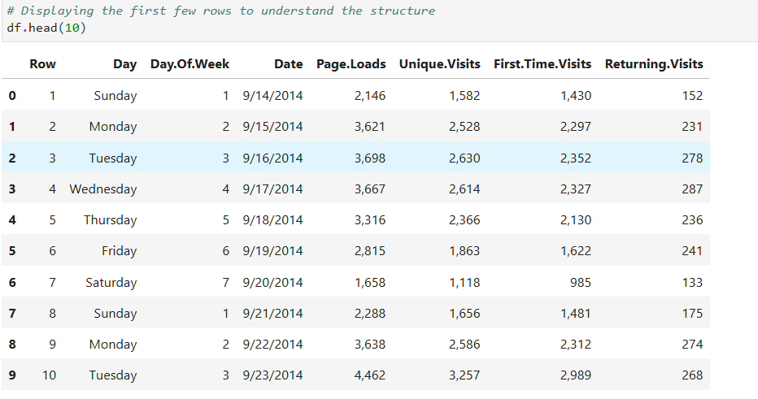
Displaying the first few rows to understand the structure of dataset

Slide 4
Description of the Dataset
The dataset includes:
Input Variables: Day, Day of Week, Date, Page Loads, First time visits, returning visits.
Target Variable: Our primary target variable is Unique visits.

Slide 5
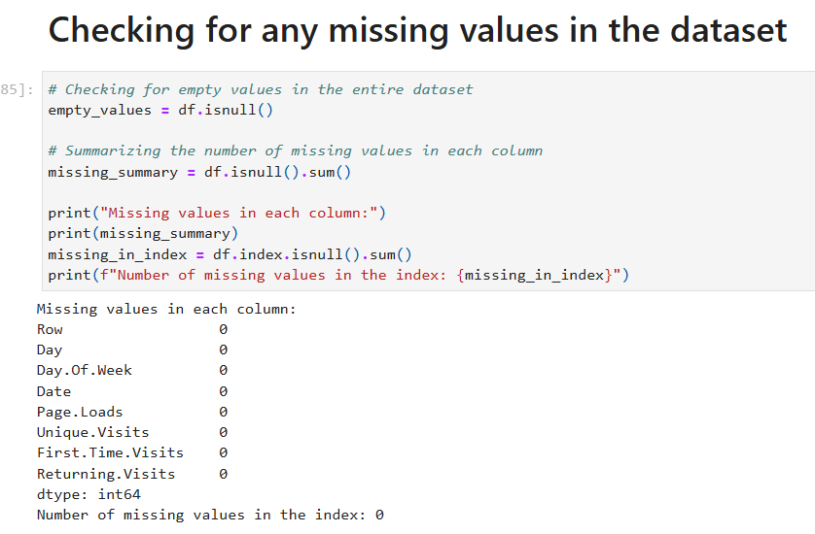
Checking for any missing values in the dataset (Since date column is set as index, index is checked for missing values)

Slide 6
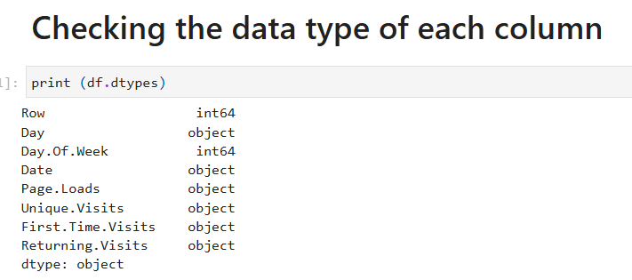
Checking the data type of each column

Slide 7
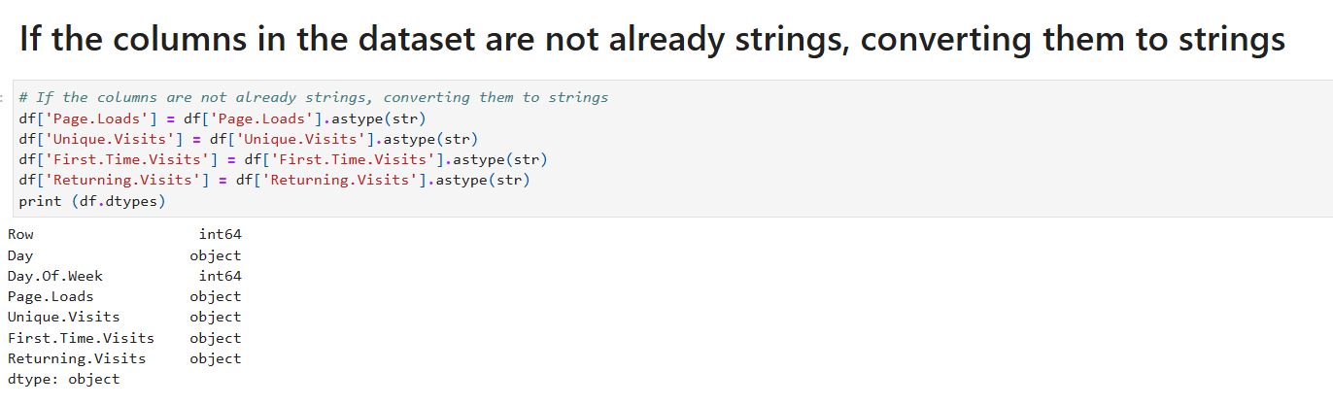
Converting all columns into datatype of strings for uniformity in dataset

Slide 8
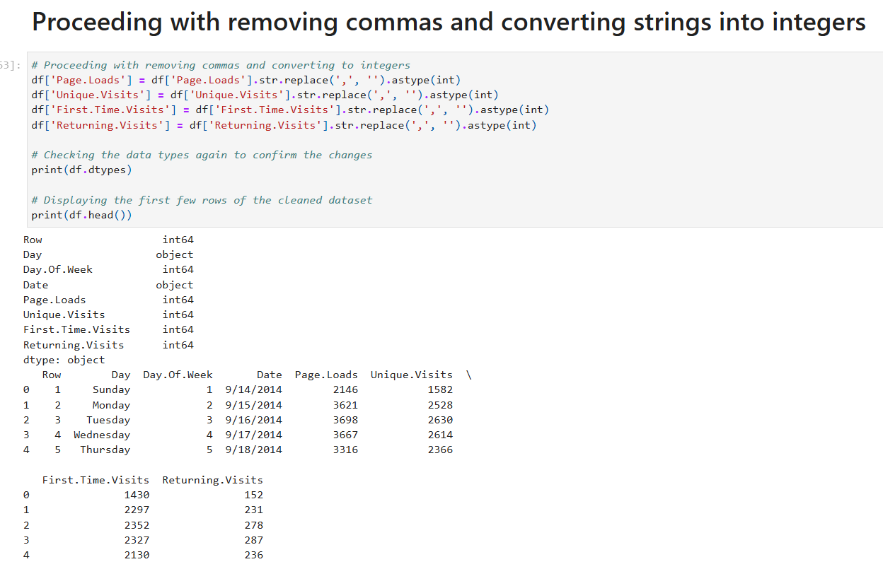
Converting all columns into datatype of int for our analysis and displaying few rows of cleaned dataset

Slide 9
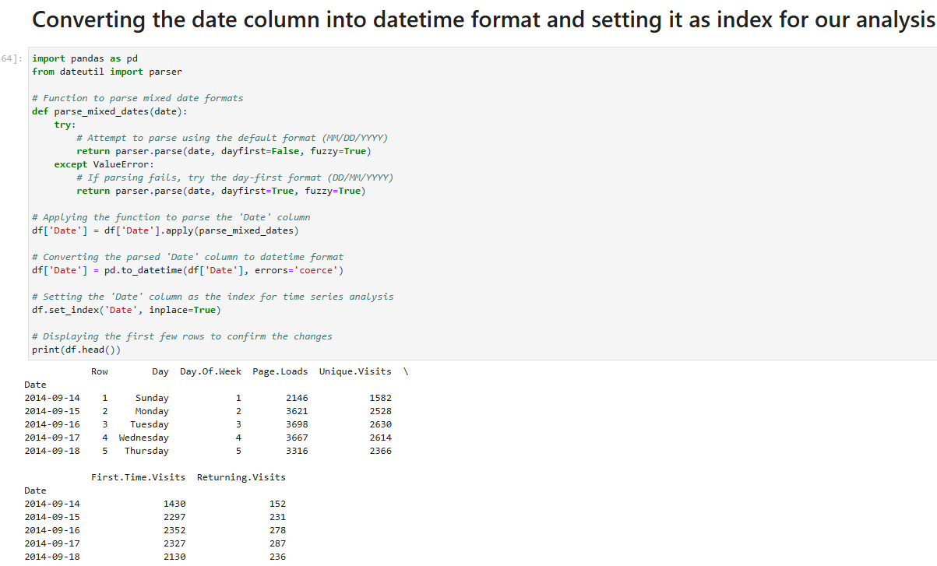
Converting the date column into datetime format and setting it as index for our analysis

Slide 10
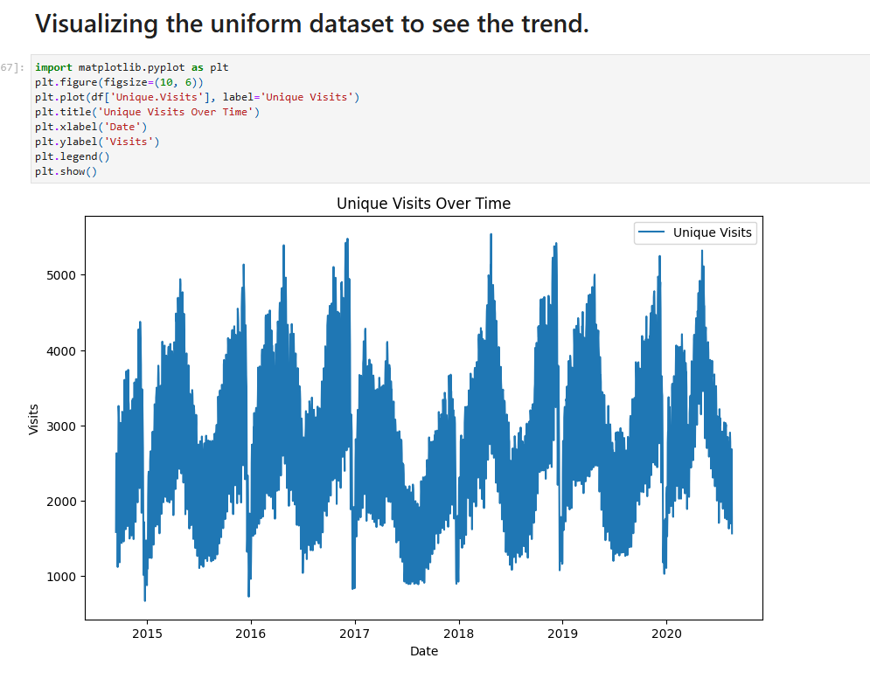
Visualizing the uniform dataset to see the trend

Slide 11
Insights from obtained graph
Seasonality in Sales:
The sales data exhibits strong seasonal patterns, with peaks and troughs recurring consistently each year. This indicates predictable periods of high and low sales, likely aligned with specific events or holidays.
Growth Over Time:
While the peaks and troughs are consistent, the overall sales trend seems to be relatively stable, with minor fluctuations. This suggests the business might not be experiencing significant growth but is maintaining steady performance.
Periodic Spikes:
Sharp spikes in sales occur at regular intervals, likely corresponding to specific promotions, sales events, or holiday seasons.
Periods of Low Activity:
There are clear periods of reduced sales activity each year, which might reflect slower business during off-peak seasons. These periods could be an opportunity for targeted promotions to boost sales during downtime.

Slide 12
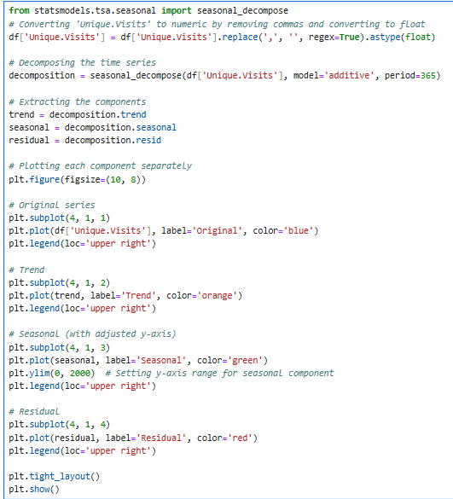
Using Seasonal Decompose to see Trend, Seasonality and Noise (Residuals) separately

Slide 13
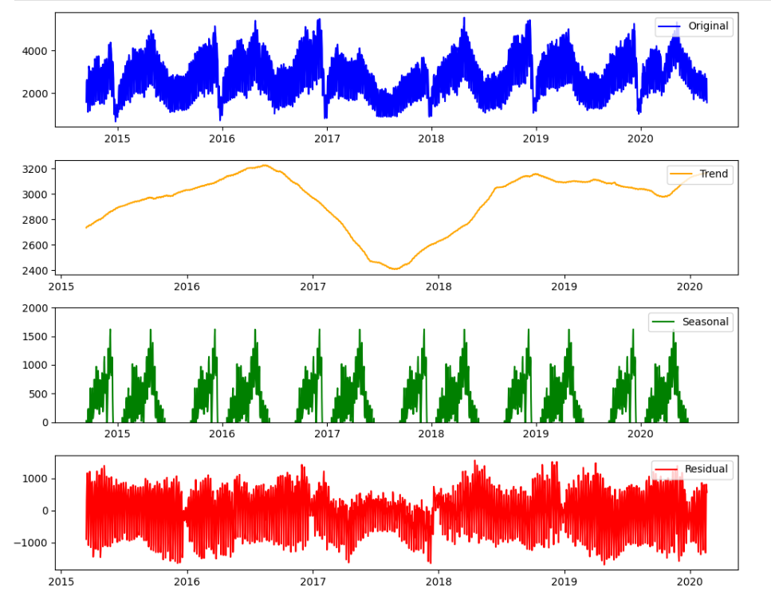

Slide 14
Insights from obtained graph
The seasonal decomposition of the time series graph reveals the following key insights:
Trend Component:
The trend line (second graph in the decomposition) shows a gradual rise and fall over the years, indicating a long-term upward and downward movement in the data. For example, there is a noticeable peak around 2017, followed by a decline, and then a gradual rise near 2020.
Seasonal Component:
The seasonal component (third graph in the decomposition) highlights a consistent recurring pattern. This shows that there is a strong seasonal effect that repeats periodically (likely annually), where certain times of the year consistently exhibit higher or lower activity.
Residual Component:
The residual (fourth graph) captures the noise or unexplained variation in the data after removing the trend and seasonal components. This part represents random fluctuations that cannot be attributed to either trend or seasonality.
Overall Interpretation:
The original time series is clearly influenced by both seasonal and trend components. The strong seasonal pattern suggests predictable periodic fluctuations, while the trend indicates an underlying gradual shift in the data over time. The residuals show variability that could represent anomalies or data noise.

Slide 15
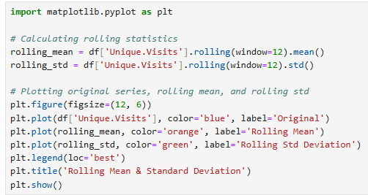
Visualizing Rolling Mean and Standard deviation

Slide 16
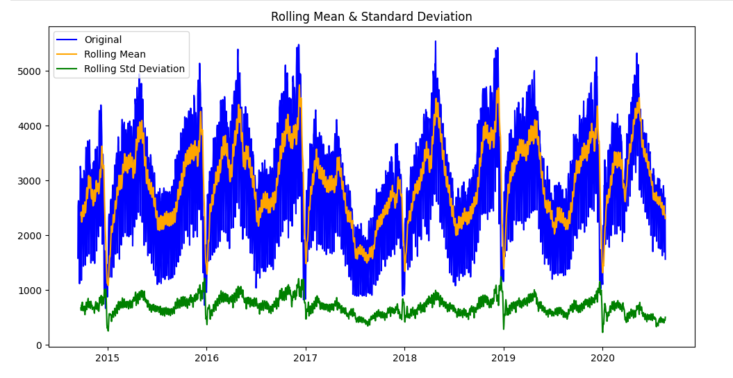
Visualizing Rolling Mean and Standard deviation
The rolling mean closely follows the seasonal patterns of the original data. This indicates that the series has strong seasonality with consistent peaks and troughs over time.
The rolling standard deviation is relatively low compared to the scale of the data and seems fairly stable over time. This suggests that the variability around the mean remains relatively consistent despite the seasonal patterns in the data.

Slide 17
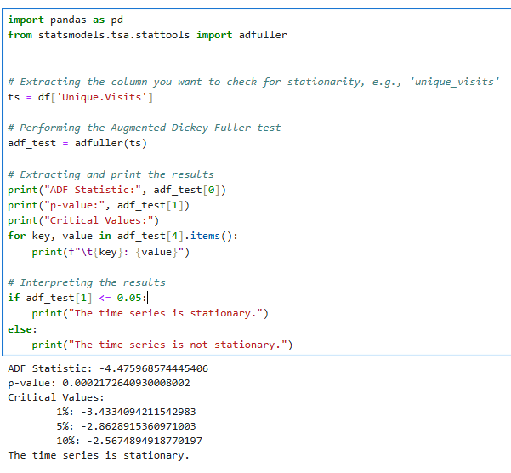
Checking for stationarity using Augmented Dickey Fuller Test

Slide 18
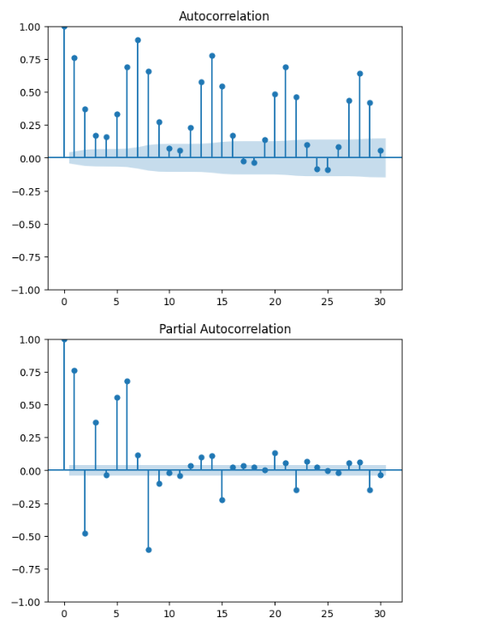
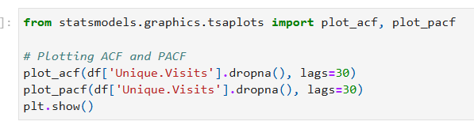
Plotting Autocorrelation and Partial Autocorrelation

Slide 19
Insights from obtained graph
Autocorrelation (ACF) Plot:
Significant Correlation at Early Lags: Strong spikes at initial lags indicate that observations are highly correlated over short time intervals.
Decay in Correlation Over Time: Gradual decrease in correlation as lag increases suggests a trend or diminishing influence of past observations.
Indication of Seasonality: Noticeable peaks at regular intervals point to a potential seasonal pattern or repeated cycles in the data.
Partial Autocorrelation (PACF) Plot:
Strong Direct Effect at Lag 1: The first lag has a significant spike, showing a direct effect of immediate past values, likely indicating an autoregressive process.
Diminishing Short-Term Dependencies: Correlations beyond lag 1 diminish quickly, with only a few lags showing minor significance.
Weaker Evidence of Seasonality: The PACF lacks strong, regular peaks, suggesting the seasonal effect may not be directly tied to specific lags but mediated through cumulative relationships.

Slide 20
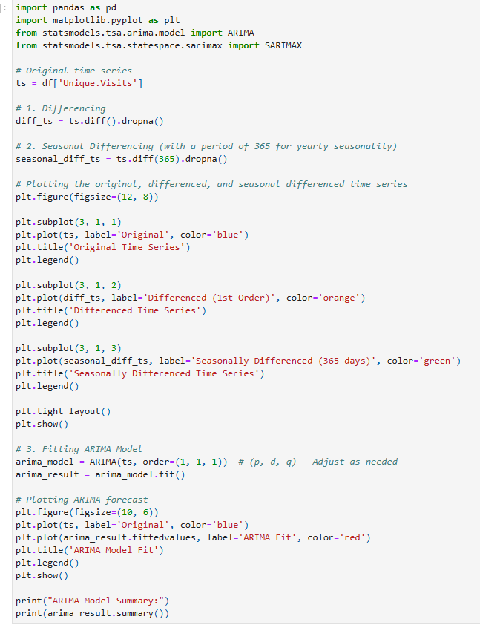
Preprocessing and fitting the time series in ARIMA Model

Slide 21
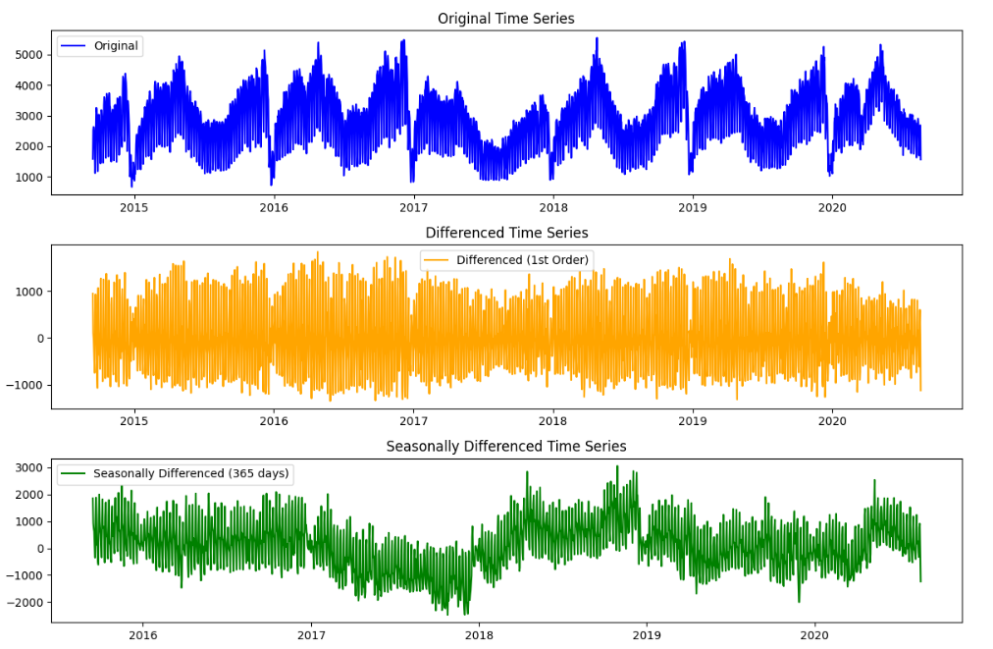
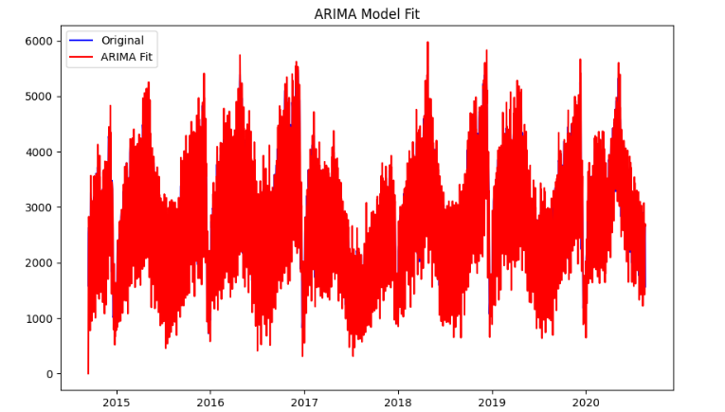
Preprocessing and fitting the time series in ARIMA Model

Slide 22
Insights from obtained graph
ARIMA Model Fit:
The red ARIMA fit closely follows the original data (blue line), indicating that the model is effective at capturing both trend and seasonal patterns. This suggests a well-fitted ARIMA model for forecasting.
First Order Differencing:
The second graph demonstrates the differenced time series, which removes the trend. This transforms the data into a stationary series, necessary for ARIMA modeling. The fluctuations now center around zero, confirming the removal of trends.
Seasonally Differenced Time Series:
The third graph (in second graph i.e. green line) shows seasonally differenced data, accounting for annual seasonality. This ensures that the model adjusts for repeating seasonal effects, making it more accurate for periodic data patterns.
Model Robustness:
The transformation steps (trend differencing and seasonal differencing) effectively prepared the data for ARIMA modeling, leading to a robust model that captures underlying dynamics for forecasting sales accurately. The residual randomness in differenced graphs indicates minimal unexplained variance.

Slide 23
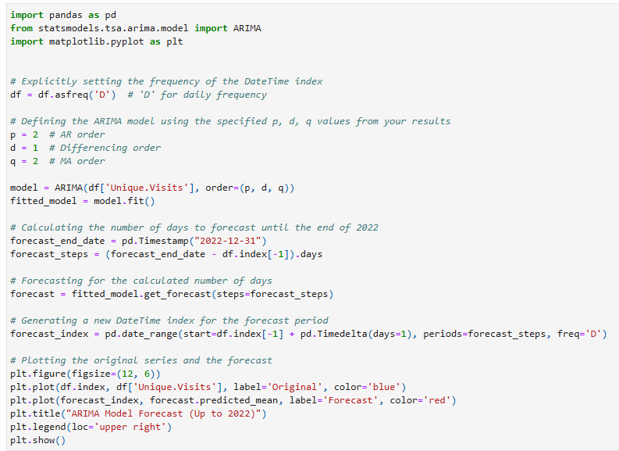
ARIMA Model forecast (upto 2022)

Slide 24
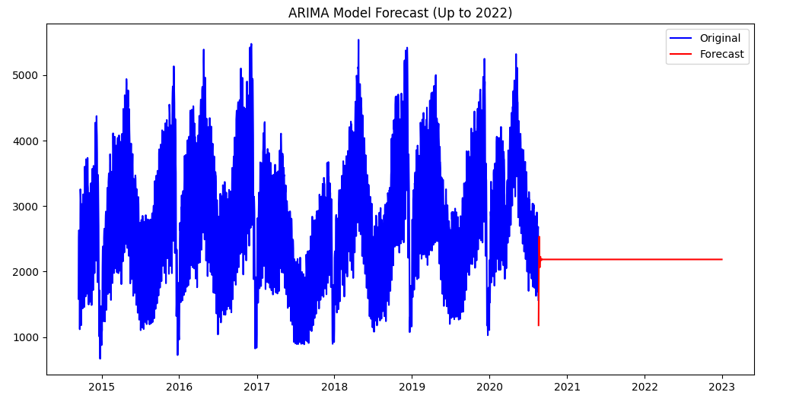
ARIMA Model forecast (upto 2022)

Slide 25
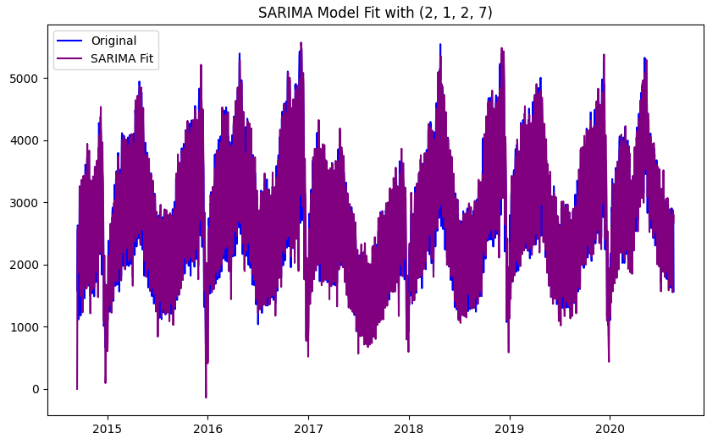
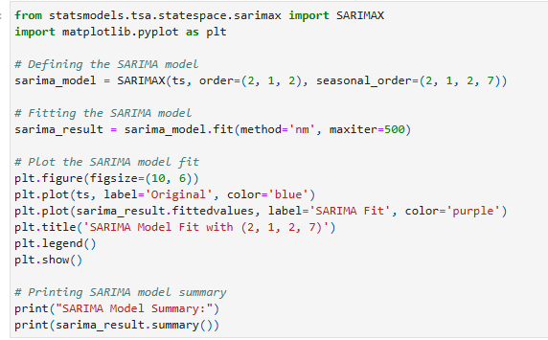
Fitting modelled SARIMA model with original data to see the fit

Slide 26
Insights from obtained graph
Seasonal Adjustment:
The SARIMA model effectively captures the seasonal patterns in the data, as indicated by the close alignment between the original data (blue) and the SARIMA fit (purple). This suggests that the model successfully accounts for recurring seasonal effects.
Enhanced Model Performance:
Compared to a standard ARIMA model, SARIMA incorporates both seasonal differencing and seasonal autoregressive/moving average components, leading to a more precise fit for data with significant seasonality.
Parameter Selection:
The specified parameters (2,1,2,7) suggest that the model includes seasonal adjustments over a 7-period cycle (likely weekly), along with autoregressive, differencing, and moving average terms tailored to the dataset's structure.
Forecasting Capability:
The close overlap between the SARIMA fit and the actual data indicates strong forecasting accuracy, especially for scenarios involving periodic or seasonal data. This makes SARIMA a reliable choice for predicting future trends and seasonal sales behavior.

Slide 27
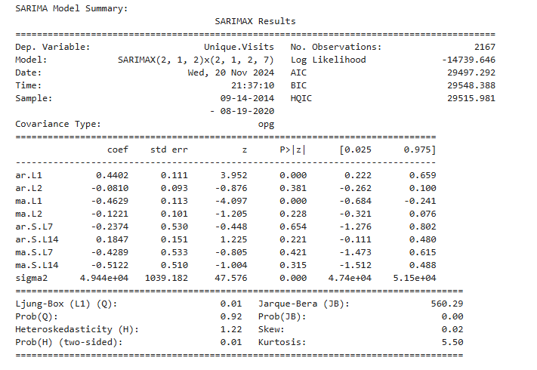
SARIMA Model Summary
Model Configuration and Scope:
The SARIMA model is configured with both non-seasonal and seasonal components to account for short-term trends and weekly seasonality (period = 7 days).
The model spans over six years (2014–2020) and uses 2167 observations, indicating a robust dataset.
Model Fit Quality:
Low AIC, BIC, and HQIC values suggest the model achieves a reasonable balance between complexity and fit.
Residual diagnostics (Ljung-Box Q-test with Prob(Q) = 0.92) indicate that the model sufficiently captures the autocorrelations in the data, with no significant pattern left unexplained.

Slide 28
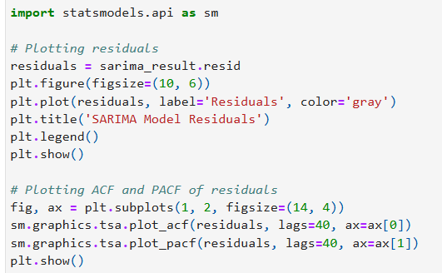
Residuals for SARIMA model

Slide 29
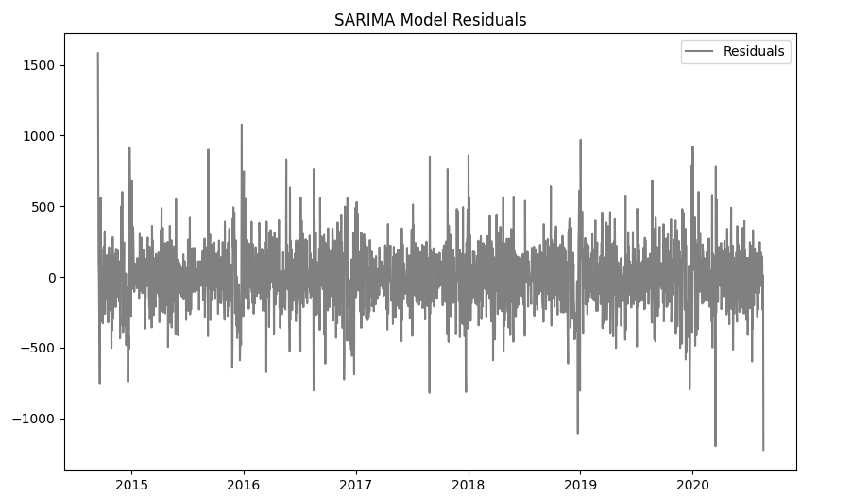
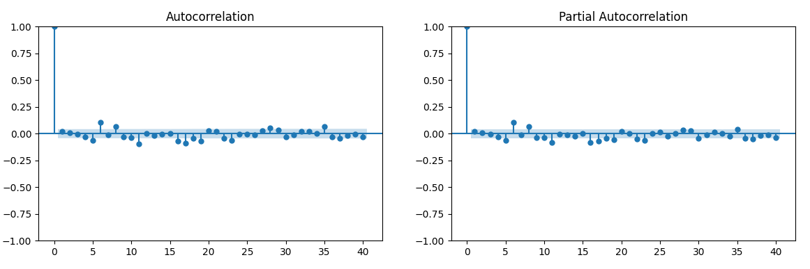
Residuals for SARIMA model

Slide 30
Insights from obtained graph
Residual Centering Around Zero:
The residuals are centered around zero, indicating that the SARIMA model has effectively captured the main patterns (trend and seasonality) in the data. Any remaining variation is random and not systematic.
Randomness in Residuals:
The residuals appear random with no discernible pattern, suggesting that the SARIMA model does not leave significant structured information unexplained. This is a good indicator of model adequacy.
No Significant Autocorrelation in Residuals:
The autocorrelation (ACF) plot shows that most lags fall within the confidence interval, indicating no significant autocorrelation in the residuals. This confirms that the SARIMA model has successfully captured the main patterns in the data, leaving residuals that are random.
Partial Autocorrelation Validates Model Fit:
The partial autocorrelation (PACF) plot similarly shows no significant values outside the confidence interval for most lags, suggesting that no additional lags of the data could significantly improve the model fit. This validates the chosen SARIMA parameters.

Slide 31
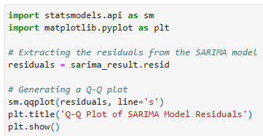
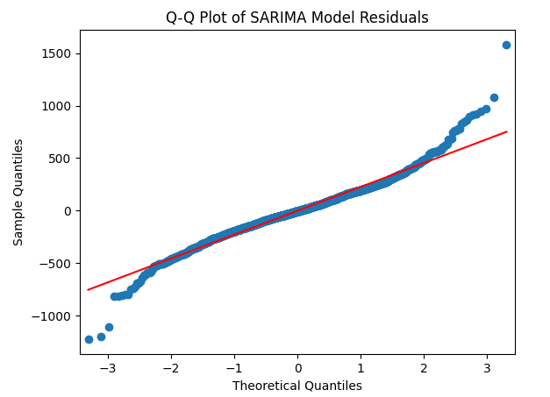
Q-Q Plot of SARIMA model

Slide 32
Insights from obtained graph
Normality of Residuals:
The Q-Q plot indicates that the residuals mostly align with the diagonal red line, suggesting that the residuals approximately follow a normal distribution. This is a desirable property for residuals in time series models.
Deviations at Extremes:
There are deviations from the red line at both tails of the distribution (extremes). This indicates the presence of outliers or heavier tails than a perfect normal distribution, which could affect the model’s performance during rare or extreme events.
Good Fit in Central Quantiles:
The central portion of the plot (close to the mean) closely matches the red line, demonstrating that the SARIMA model effectively captures the main patterns in the majority of the data.

Slide 33
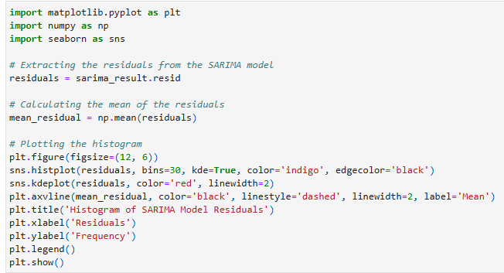
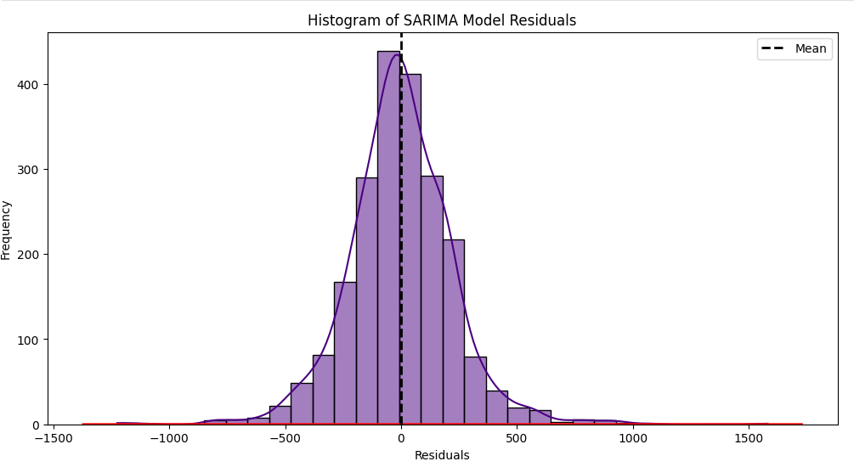
Histogram of SARIMA Model Residuals

Slide 34
Insights from obtained graph
Residual Distribution is Approximately Normal:
The histogram of residuals forms a bell-shaped curve, indicating that the residuals are approximately normally distributed. This supports the assumption that the SARIMA model has captured the data's underlying patterns effectively.
Mean Close to Zero:
The dashed vertical line represents the mean of the residuals, which is close to zero. This implies that the model's predictions are unbiased, as the residuals (prediction errors) do not systematically lean positive or negative.
Symmetry Around Zero:
The histogram shows a reasonably symmetrical distribution around zero, further confirming that the residuals are well-behaved and do not exhibit skewness.
Presence of Outliers:
There are some residuals in the far ends of the distribution (both tails), indicating occasional outliers or extreme prediction errors. These could represent anomalies in the data or events that the model could not fully capture, suggesting an area for further investigation or model refinement.

Slide 35
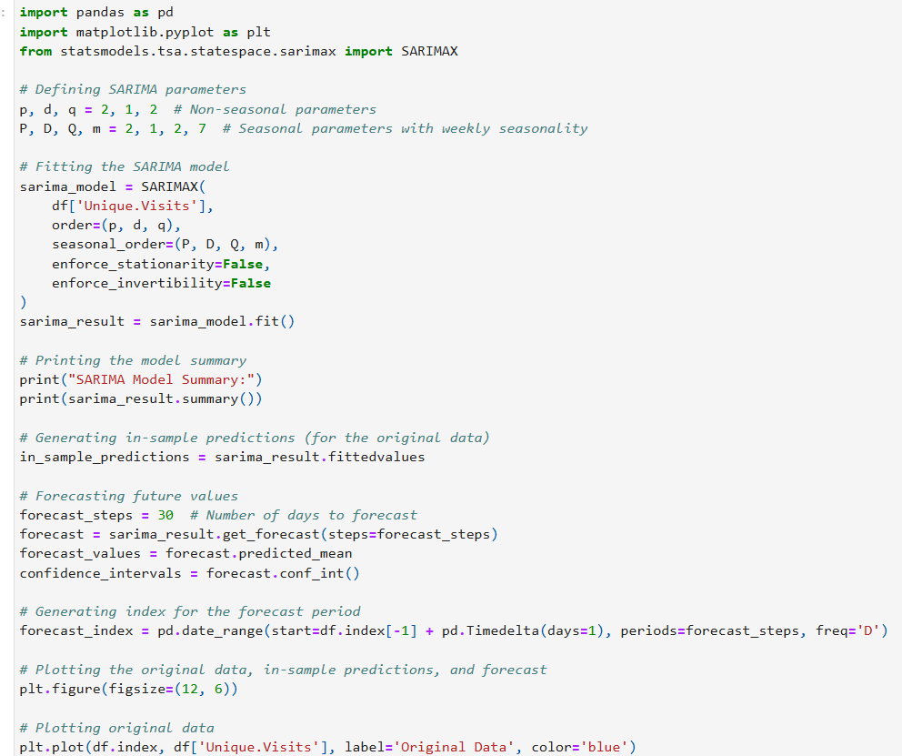
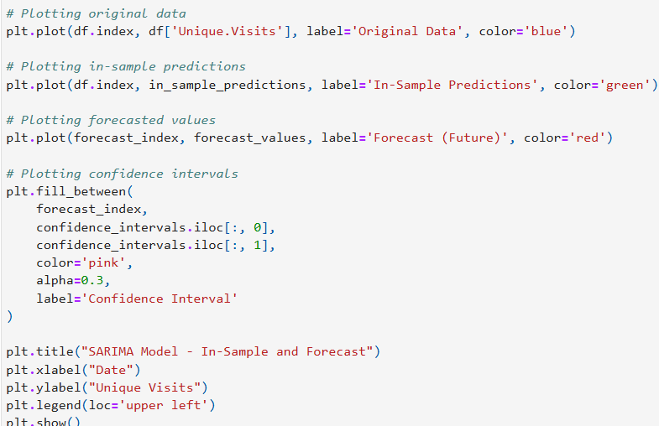
SARIMA Model Prediction and In-sample forecast

Slide 36
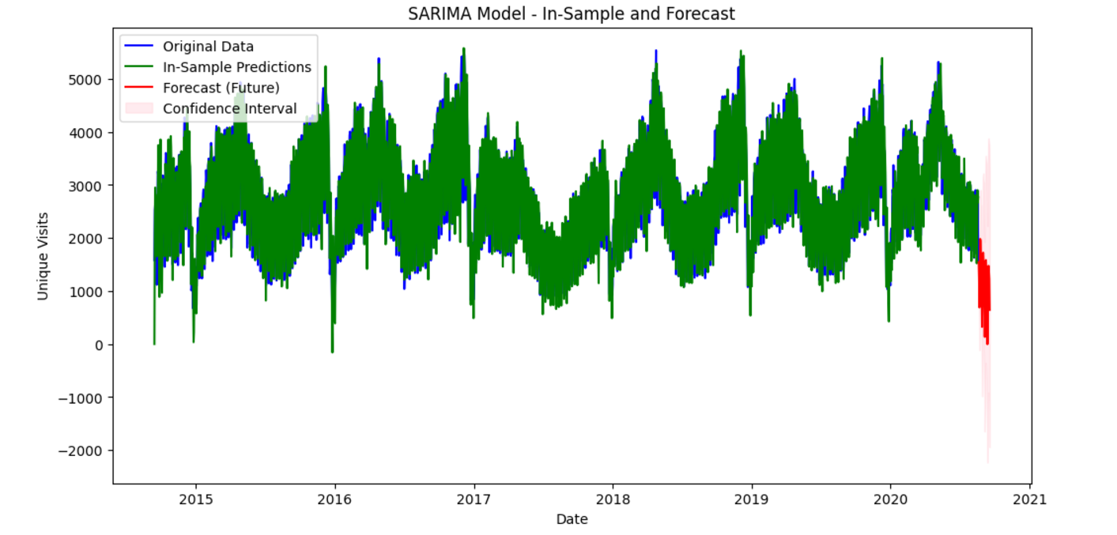
SARIMA Model Prediction for In-sample forecast and near future forecast

Slide 37
Insights from obtained graph
Accurate In-Sample Predictions:
The green line (in-sample predictions) closely overlaps the blue line (original data), indicating that the SARIMA model has a strong fit and accurately captures historical patterns, including trends and seasonality.
Future Forecast:
The red section represents the forecasted values, which align well with the general pattern and seasonality of the previous data, demonstrating the model's ability to predict future trends reliably.
Confidence Intervals:
The shaded area around the forecast (light red) represents the confidence intervals. While the intervals widen slightly into the future, they remain relatively narrow, suggesting a high degree of confidence in the model’s predictions for the near term.
Seasonal Pattern Continuation:
The forecasted data continues to exhibit the seasonal patterns observed in the historical data, indicating that the model successfully extrapolates recurring trends into the future, making it suitable for planning and decision-making.

Slide 38
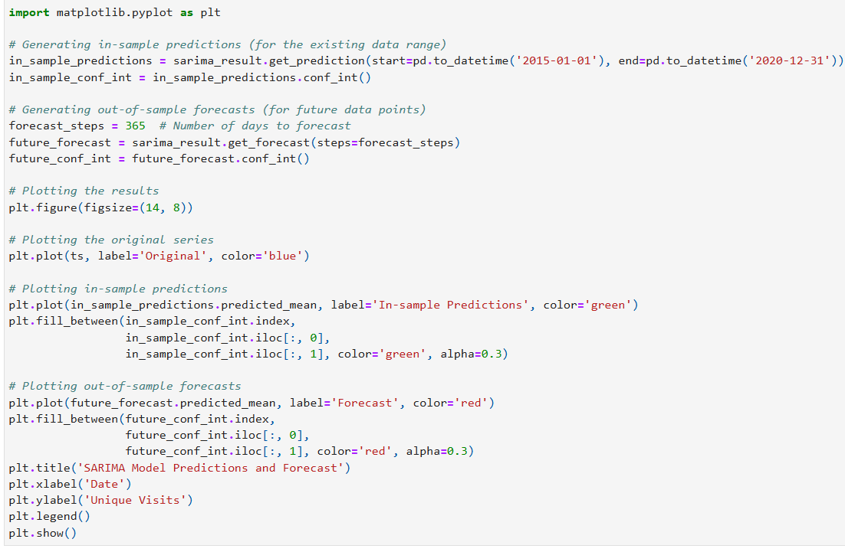
SARIMA Model Predictions and Future Forecast

Slide 39
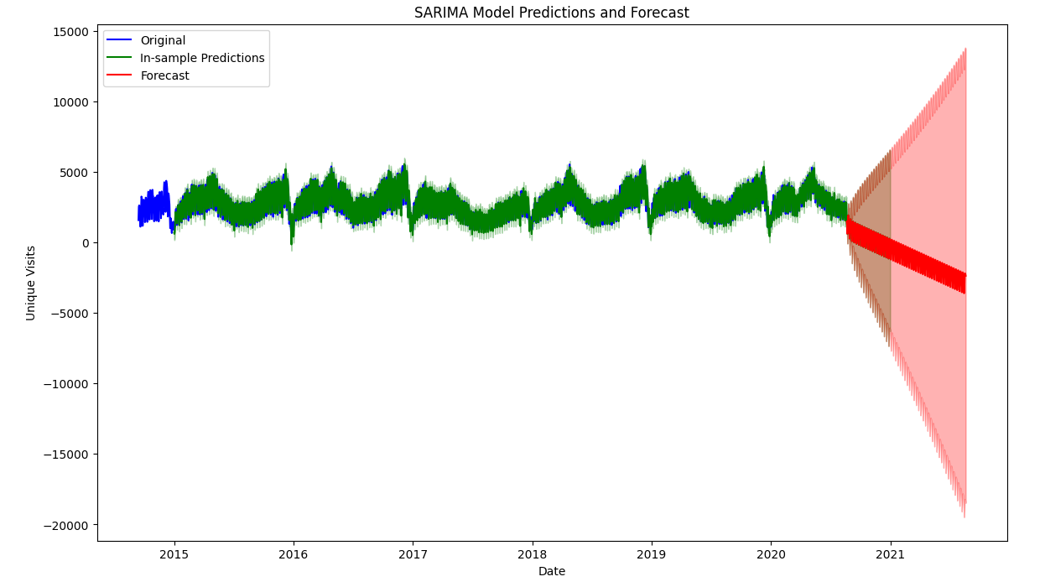
SARIMA Model Predictions for extended Future Forecast

Slide 40
Insights from obtained graph
Stable In-Sample Predictions:
The green line (in-sample predictions) closely follows the original data (blue line) for the historical period, confirming that the SARIMA model captures the trends and seasonality accurately for the observed data.
Widening Confidence Intervals:
As the forecast extends into the future (red line), the confidence intervals (shaded area) widen significantly. This reflects increased uncertainty in the model's predictions for more distant time points, a common characteristic of time series forecasting.
Seasonality Continuation:
Despite the widening intervals, the forecasted red line maintains the seasonal structure observed in the historical data. This demonstrates the model's ability to extrapolate recurring patterns, which can be used for long-term planning.
Potential Risk of Large Deviations:
The extreme widening of confidence intervals suggests that the SARIMA model may struggle with providing reliable forecasts over extended horizons. Users should exercise caution and combine the forecast with other insights or shorter-term models for long-term decision-making.

Slide 41
Conclusions
Objective and Approach:
The goal was to analyze the time series data of online shop visits and predict unique visits using statistical and machine learning models.
Methods employed included data preprocessing, exploratory data analysis (EDA), and fitting ARIMA and SARIMA models for robust forecasting.
Key Findings:
Seasonality: The dataset exhibited strong seasonal patterns with recurring peaks and troughs, aligning with specific periods or events (e.g., holidays, promotions).
Trend: The overall trend showed stability with periodic fluctuations, indicating consistent but not rapidly growing performance.
Residual Analysis: Randomness in residuals confirmed the robustness of the SARIMA model in capturing the primary patterns (trend and seasonality).

Slide 42
Conclusions
Model Insights:
ARIMA and SARIMA Performance:
ARIMA effectively captured trends and seasonality, but SARIMA outperformed it by integrating seasonal adjustments for weekly cycles.
SARIMA predictions closely aligned with actual data, with narrow confidence intervals for short-term forecasting.
Forecasting:
Both in-sample and future forecasts successfully predicted unique visits, extending seasonal trends with high accuracy.
Confidence intervals widened for longer-term forecasts, reflecting natural uncertainty over extended horizons.
The SARIMA model provides a reliable framework for predicting future visits, aiding in demand forecasting and capacity planning.
Seasonal patterns can guide targeted promotions during low-activity periods and optimize resource allocation during peak times.

Slide 43
Thank you

